Slide 1

Academic Excellence Journey Of Career Grow
A Tale of Achievements and Grades

Slide 2
Note to reader
Career Grow in an institute where the students are getting prepared for their future. We take some students' data which is used for our project.
Across the project, we used the same data set for our three different formulas. Here we are presenting the same result but in three different ways. As we all know excel is the piler of all data industry. So here we are introducing that dynamic side of Excel throughout the project.

Slide 3
Content
Grading input
Our three different formulas
First formula (IF)
Second formula (LOOK-UP)
Third formula (MATCH)
Output
Conclusion

Slide 4
Grading input
Career Grow’s student result data are based on some grading method. This grade will help you to understand the student’s progress and their academic achievements across a spectrum of scores. Here’s the breakdown of the grading system.
Group details
Marks Group | Grade
10-29 | D
30-49 | C
50-69 | B
70-79 | A
80-89 | A+
90-100 | AA

Slide 5
Our grading formula explanation
If Function | Look-up Function | Match Function
At the core of our formula is the IF function, a powerful tool in Excel that allows us to apply conditional logic. The formula is used for this function is : IF(“cell reference”>=90, "AA", IF(F3>=80, "A+", IF(F3>=70, "A", IF(F3>=50, "B", IF(F3>=30, "C", "D"))))) | Our formula relies on the VLOOKUP function, a robust feature in Excel for looking up values in a table and returning a corresponding result. The formula is used for this function is : IFERROR(VLOOKUP (“cell reference”, {0,"D";30,"C";50,"B";70,"A";80,"A+";90,"AA"}, 2, TRUE), "Invalid") | Our formula kicks off with the MATCH function, a versatile Excel feature for finding the position of a value in a range. The formula is used for this function is : IFERROR(CHOOSE(MATCH( “cell reference”, {0,30,50,70,80,90}, 1), "D", "C", "B", "A", "A+", "AA"), "Invalid")

Slide 6
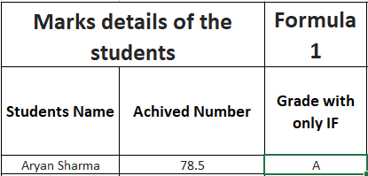
Grading with IF function
If the function is one of the primary functions in the Excel tool. This function is very simple to explain and useful. Here we are using this IF formula with multiple nested IF statements and creating a step-by-step evolution.

Slide 7
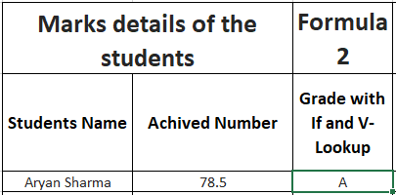
Grading with LOOK-UP function
The look-up function is the advanced level of the Excel tool. This function helps to search the look-up value for the given cell from the other table. We are using the V-LOOKUP function for this calculation.
The VLOOKUP function searches for the achieved number (in cell G6) within the first column of the lookup table.

Slide 8
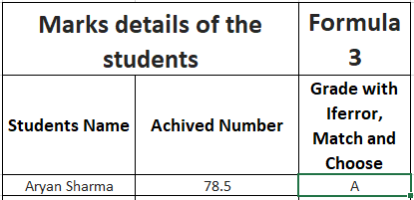
Grading with MATCH function
Our third and final function is the MATCH function. This function is one of the dynamic and versatile features. In this calculation, we are using a combination of MATCH and CHOOSE formulas for dynamic grading experience.
By combining the power of MATCH and CHOOSE, we've created a flexible grading formula that dynamically selects grades based on achieved numbers. The IFERROR adds a layer of reliability, making our grading system robust and error-tolerant.

Slide 9
Analytical Explanation
Formula 1- Decision Tree Logic - Strategic Precision :
The first formula, with its decision tree logic, mirrors strategic decision-making. The adaptability and precision it offers resonate with strategic agility in a dynamic business environment.
Formula 2 - Efficient Lookup - Data-Driven Insight :
The use of VLOOKUP embodies efficient data retrieval, akin to how businesses rely on accurate and swiftly accessible information for informed decision-making.
Formula 3 - CHOOSE-MATCH Logic - Scalability and Customization:
The third formula, with its CHOOSE-MATCH logic, offers scalability and customization, aligning with the adaptability and flexibility essential for business strategies.

Slide 10
Conclusion
We are grateful to the Career Growth for sharing the student’s data. With the help of the data, we can discuss three different formulas in detail. Our goal was for one query we will use three different formulas and get the same answer.

